Slide 1
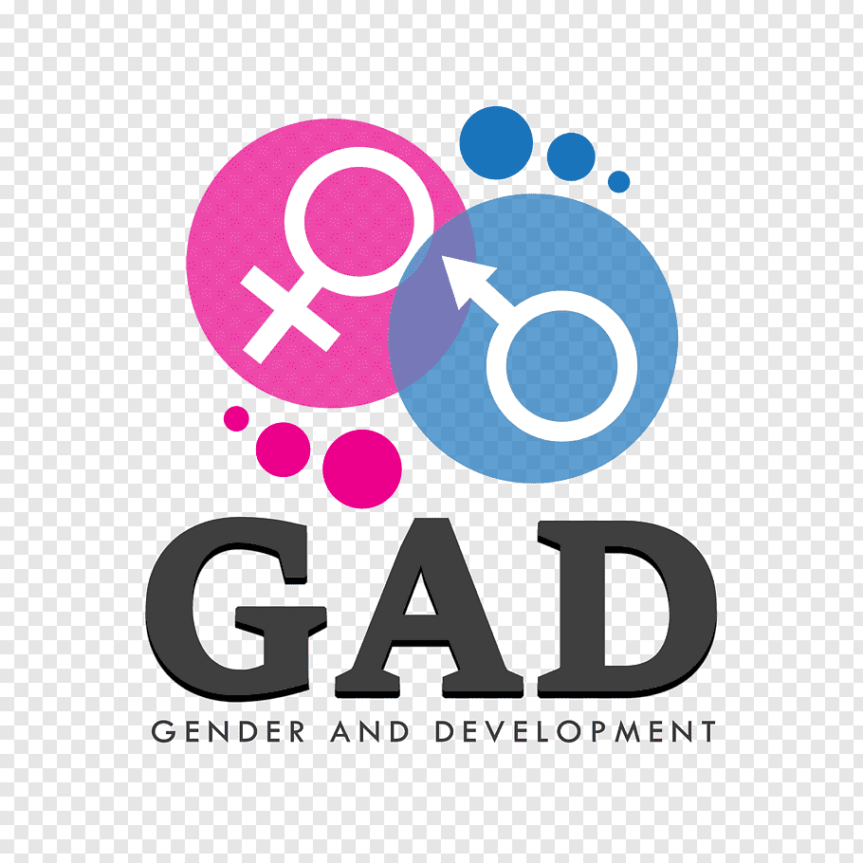

Slide 2
Key concepts of Gender and Development
Definition of Gender
Difference between Gender and sex
Gender Roles
Gender (stereotyping)
Gender Equity and Equality
Gender awareness
Patriarchal System
Strategic Gender Needs

Slide 3
Definition of Gender
The word gender comes from the Middle English gendre. This , in turn, came from Latin genus. Both words mean ‘kind’, ‘type’, or ‘sort’. The historical meaning of gender is something like “things we treat differently because of their inherent differences”.

Slide 4
Gender describe the characteristics that a society or culture defines as masculine or feminine.
The World Health Organization (WHO) defines gender as:
“Gender refers to the socially constructed characteristics of women and men, such as norms, roles, and relationships of and between groups of women and men. It varies from society to society and can be changed.”
(Gender roles in some societies are more rigid than those in others.)
The concept of Gender also includes the expectations held about the characteristics, aptitudes and likely behaviors of both women and men. Gender carries a more social tone. Meaning that it refers to the different clothing, activities, career choices, and positions people hold in society.A

Slide 5
Gender identifies the social relationships between men and women, shaped by different social, historical and cultural values.
These values determine the roles that women and men play in all fields of life.
It identifies socially learned behavior and expectations associated with the two sexes attributed by a given culture.
They can change over time and they vary within and between culture.
just a few examples: chances and opportunities, the access to job and decisions, the way of thinking and behaving are not the same for men an women and it is this way because of social and cultural reasons.

Slide 6
SEX
refers to biological differences; chromosomes, hormonal profiles, internal and external sex organs. Sex is a more scientific term that explains physical traits and sexual preferences. Sex describes the biological differences between men and women, which are universal and determined at birth.

Slide 7
Difference between Gender and sex
“Sex is a biological characteristics; gender is a social characteristics.”

Slide 8
Categorized as male or female
Biological
Fixed at birth
Does not change across time and space
Equally valued
Masculinity and femininity
Socially, culturally and historically determined
Learned through socialization
Varies over time and space
Unequally valued
Sex
Gender

Slide 9
Gender roles
Refers to what males and females are expected to do(in the household, community and workplace) in a given society.

Slide 10
Gender Role Stereotyping
It is the constant portrayal, such as in the media or in books, of women and men occupying social roles according to the traditional gender division of labor in a particular society. Such gender role stereotyping works to support and reinforce the traditional gender division of labor by portraying it as “normal” an “natural”.

Slide 11
Genger Equity and equality
Gender equity
The principle and practices of fairness and justice in the distribution of benefits, resources and responsibilities between men and women is known as gender equity. The concept recognizes that women and men have different needs and that these differences should be identified in a manner that reduces the imbalance between the sexes.

Slide 12
Gender equality
Absence of discrimination on the basis of a person’s sex in opportunities and the allocation of resources and benefits or in excess to services is known as “Gender Equality”.
Or
Gender equality means that women should have the same rights and privileges as men to human, social economic and cultural development, and an equal voice in civil and political life.

Slide 13
Difference between equity qnd equality
1. Justness and fairness in the manner of treating individuals are called equity. Equality is what we call, the state where everyone is at the same level.
2. Equity is the process while equality is the outcome.
3. While equity represents impartiality, i.e. the distribution is made in such a way to even opportunities for all the people. Conversely equality indicates uniformity, where everything is evenly distributed among people.

Slide 14
4. In equity, the differences are recognized and opportunities are not equal. On the contrary, equality recognizes sameness and so it aims at treating everyone as equal.
5. In equity, all the people can have access to what they need. The equality, in contrast, all the people get the same thing, i.e. rights , resources and opportunities.

Slide 15
Gender Awareness
It means that both women and men are working together in a harmonious way, possessing the same rights, duties, positions, roles and opportunities, and paying careful attention to the specific needs and strengths of both.

Slide 16
Patriarchal System
“Patriarchy is a social system in which the father is head of the household, having authority over women and children”.

Slide 17
The usage of the word patriarchy in the sense of a male-oriented social organization started in the English language in the 16th century. In the late 19th and early 20th centuries, patriarchy was primarily used to mean the rule or authority of fathers(patriarchs) within families.
In the 20th century, patriarchy came to be used more commonly in this broader sense to mean the rule or dominance of men generally in society, rather than simply the rule of fathers within households.
Patriarchy, literally meaning the rule of the father. It refers to a system of government by males, and to the dominance of men in social or cultural systems.

Slide 18
characteristics of patriarchal system
Male dominance
Men make all decisions in both society at large and their family units. They also hold all (or the vast majority of) positions of power and authority and are considered superior.
Male identification
Because of men's greater power in society, men are concerned with defining what makes someone "manly." This creates standards for male identification that includes qualities of control, strength, forcefulness, rationality, strong work ethic, and competitiveness.
Male centeredness
Men are the center of activity and progression in the society. They are the focus and developer of all events and inventions, the heroes in all situations, and the centers of social engagement, fun and entertainment

Slide 19
Gendered thinking of Roles
Related to the patriarchy demands that men and women each have their own specific roles in society (e.g., men leading and women supporting).
Obsession with male control
Men living in a patriarchal system or society must be in control at all times. This includes controlling all social and family situations and being in charge of all decisions regarding finances and education.

Slide 20
Patriarchal system in Pakistan
Women in Pakistan have been denied opportunities for growth in the name of religion and socio-cultural practices. Thus, women in Pakistan have few freedoms even in their homes, hold an unequal and inferior status in society, and are subject to the rule of male heads of household (their fathers in their childhoods and their husbands after marriage). Due to women's low status in Pakistani society, rape, murder, dowry, Wanni, karokri, watta satta, burning, acid attack, wife beating and discrimination are all commonplace as the expression of male dominance over women. Additionally, girls are viewed as less valuable than boys, so many families will choose to under educate their daughters. As a result, Pakistan is still in the list of developing countries.

Slide 21
Strategic Gender Needs
SGNs are the needs Woman identify because of their subordinate position in society. They vary according to particular contexts, related to gender divisions of labor, power and control, and may include such issues as legal rights, domestic violence, equal wages, and women’s control over their bodies. Meeting SGNs assists women to achieve greater equality and change existing roles, thereby challenging women’s subordinate position.

Slide 22
Strategic Gender Needs
Response to long term needs arising from women’s subordinate position
Challenge the nature of the gendered relationship between men and women
Women involved as agents of change
Lead to a transformation of gender division of labor for all women
(e.g. access to resources( Land, Credit, etc), measures against male violence, control over own body)
women’s needs differ from men’s needs because of their different position in society

